Slide 1

Defence in Depth
By-
Piyush Tiwari - 240344223027
Samarth Tamrakar - 240344223032
Saloni Jhungare - 240344223031
Kshitij Shrivastava - 240344223016

Slide 2
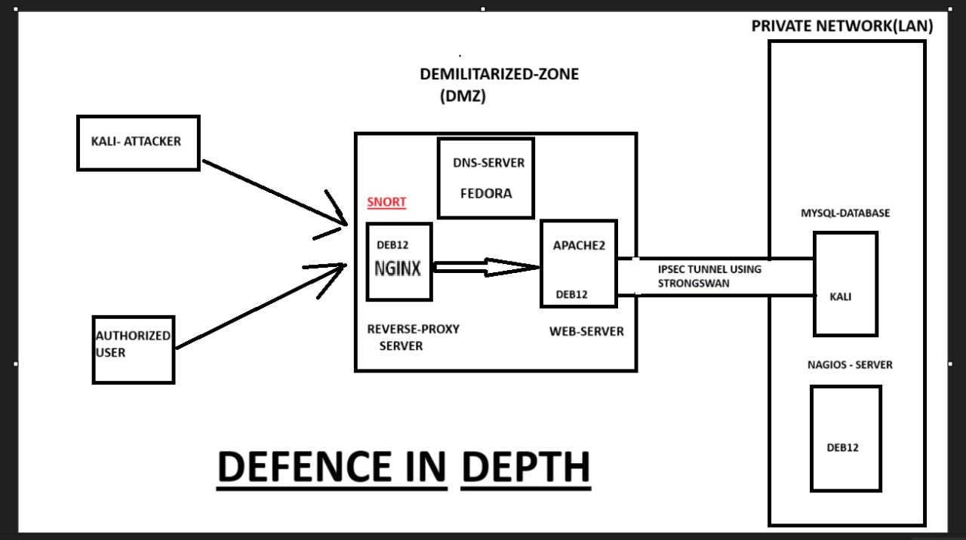

Slide 3
DMZ -
A DMZ (Demilitarized Zone) is a sub network that adds an extra layer of security to an organization’s internal LAN by isolating external-facing services from untrusted traffic. It exposes services like web servers, mail servers, and DNS servers to the internet while keeping the internal network secure. This setup ensures that even if a service in the DMZ is compromised, the internal network remains protected.
In your project, you enabled the DMZ on your wireless router to enhance security. By placing your web server in the DMZ, you made it accessible from the internet while protecting your internal network from potential threats. The DMZ acts as a buffer zone, filtering and monitoring traffic to provide an additional layer of defense against external attacks.

Slide 4


Nagios:
A Comprehensive Monitoring Solution
Nagios is a powerful open-source monitoring system designed for IT infrastructure management. It plays a crucial role in ensuring the reliability, availability, and performance of your critical systems and applications. Nagios excels at detecting anomalies, alerting administrators to potential issues, and enabling proactive troubleshooting before they escalate into major problems.

Slide 5

Importance of Nagios -
Nagios empowers organizations to maintain their IT infrastructure's health and efficiency. Its key advantages include:
1
Proactive Issue Detection
2
Enhanced Security
3
Performance Optimization
Nagios can detect suspicious activity, such as unauthorized access attempts or unusual resource consumption, enhancing security and mitigating potential threats.
Nagios continuously monitors your systems, alerting you to problems before they impact users. This proactive approach minimizes downtime and prevents service disruptions.
By identifying performance bottlenecks, Nagios helps optimize resource utilization, ensuring smooth operation and preventing system slowdowns.
4
Improved Service Availability -
By promptly alerting administrators to issues, Nagios enables swift resolution, minimizing service outages and downtime, ensuring continuous availability for users.

Slide 6
Understanding NCPA Plugins
NCPA (Nagios Cross-Platform Agent) plugins are essential components of the Nagios monitoring framework. These plugins act as agents on remote systems, collecting performance data and transmitting it to the central Nagios server. NCPA plugins enable distributed monitoring, allowing Nagios to monitor systems across diverse platforms and environments.
Benefits of NCPA Plugins
Key Features
Supported Platforms
Distributed Monitoring
NCPA plugins offer a wide range of features, including:
NCPA plugins support a wide range of platforms, including:
Cross-Platform Support
Enhanced Security
System Resource Monitoring
Linux
Reduced Network Traffic
Network Performance Analysis
Windows
Service Availability Checks
Solaris
Customizable Plugin Scripts
Unix
Mac OS X

Slide 7
The Importance of NCPA Plugins
NCPA plugins are vital for several reasons:
Simplified Monitoring -
Enhanced Granularity -
Improved Security -
NCPA plugins simplify the monitoring process by automating data collection on remote systems. This eliminates the need for manual configuration and scripting, streamlining monitoring efforts.
NCPA plugins provide detailed information about individual systems and applications, offering greater insight into performance and resource utilization. This allows for more precise analysis and problem identification.
By using NCPA plugins, you can restrict access to sensitive data on remote systems, enhancing security and limiting the potential impact of unauthorized access.
Scalability -
NCPA plugins are designed for scalability, allowing you to monitor large and complex IT environments effectively. They can handle a high volume of data and support the expansion of your monitoring infrastructure.

Slide 8
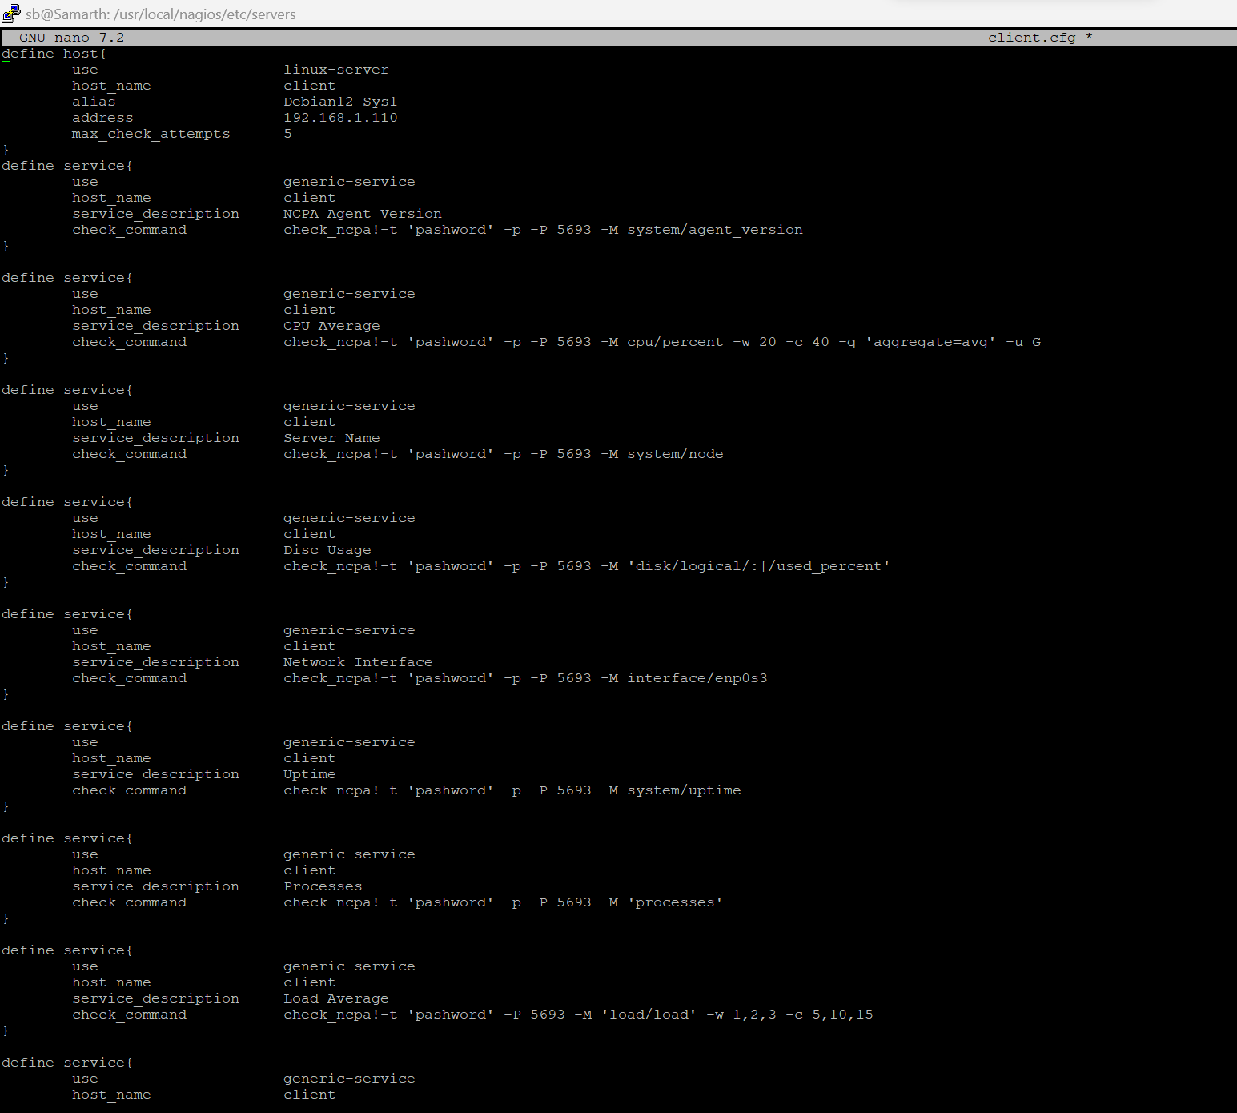
Nagios -

Slide 9
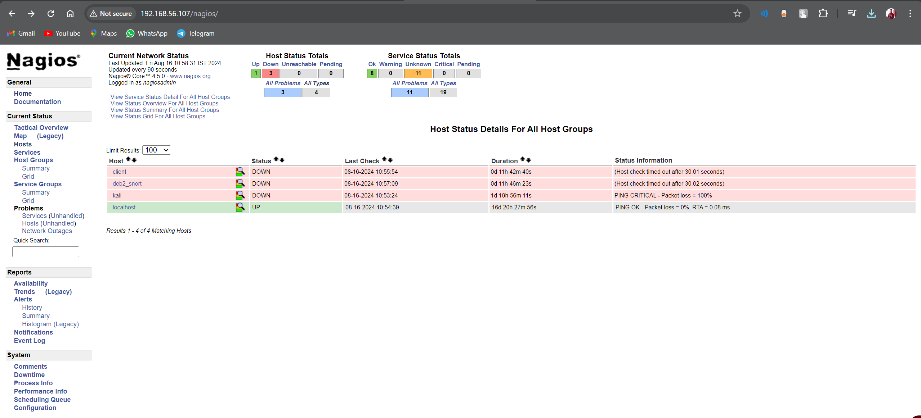
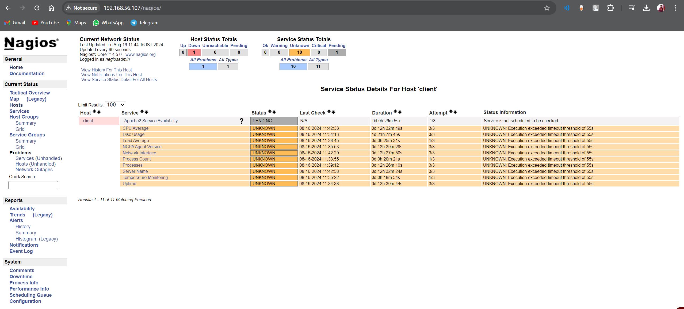
Nagios -

Slide 10
Snort -
Snort is an open-source intrusion detection and prevention system (IDS/IPS), to monitor network traffic and protect against potential threats. Snort was configured in two primary modes: alert and drop.
alert mode - allows Snort to detect malicious activities by analyzing network packets against predefined rules and then generate alerts when suspicious behavior is identified.
drop mode - to actively prevent attacks. When a packet matches a rule configured with a drop action, Snort not only generates an alert but also discards the packet, effectively stopping the malicious traffic from reaching its destination.
We used Snort in our project to demonstrate how Snort can be effectively employed to enhance network security by detecting and preventing common network attacks.

Slide 11
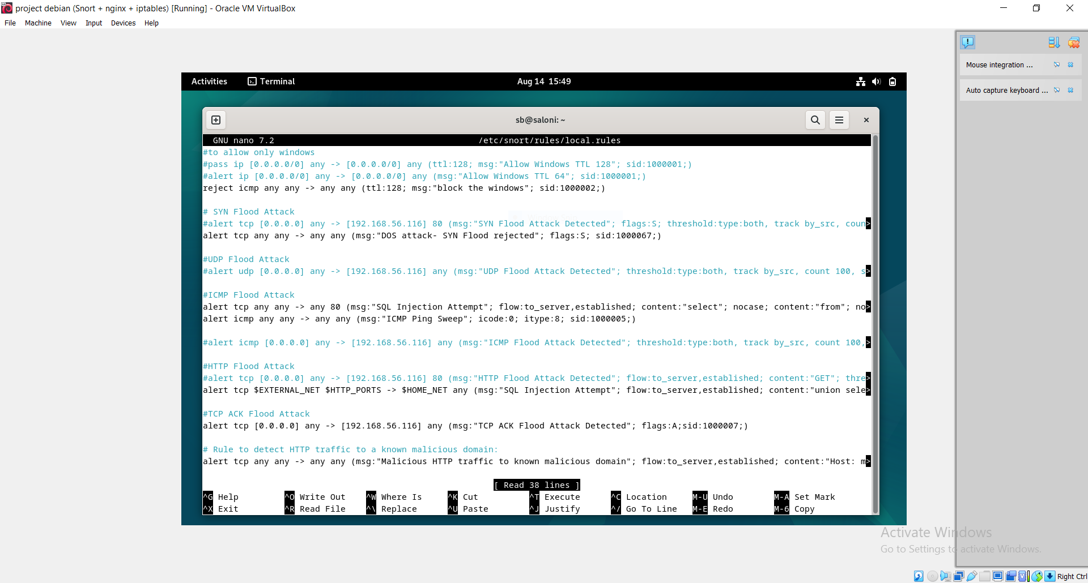
Snort -

Slide 12
SQL -
SQL (Structured Query Language) as the core tool for managing and interacting with the database. SQL played a crucial role in storing, retrieving, and manipulating data efficiently, which is essential for the smooth operation of the system.
One of the primary functions of SQL in my project was to handle user data, including registration, login authentication, and user profile management. SQL queries were used to insert new user records, update existing information, and retrieve user data based on specific criteria. This allowed for dynamic interaction with the database, enabling the application to respond to user inputs and provide relevant information.
Overall, SQL was an integral part of the project, enabling robust data management and seamless interaction between the application and the database. Its versatility and power made it the ideal choice for handling the data-driven aspects of the project.

Slide 13
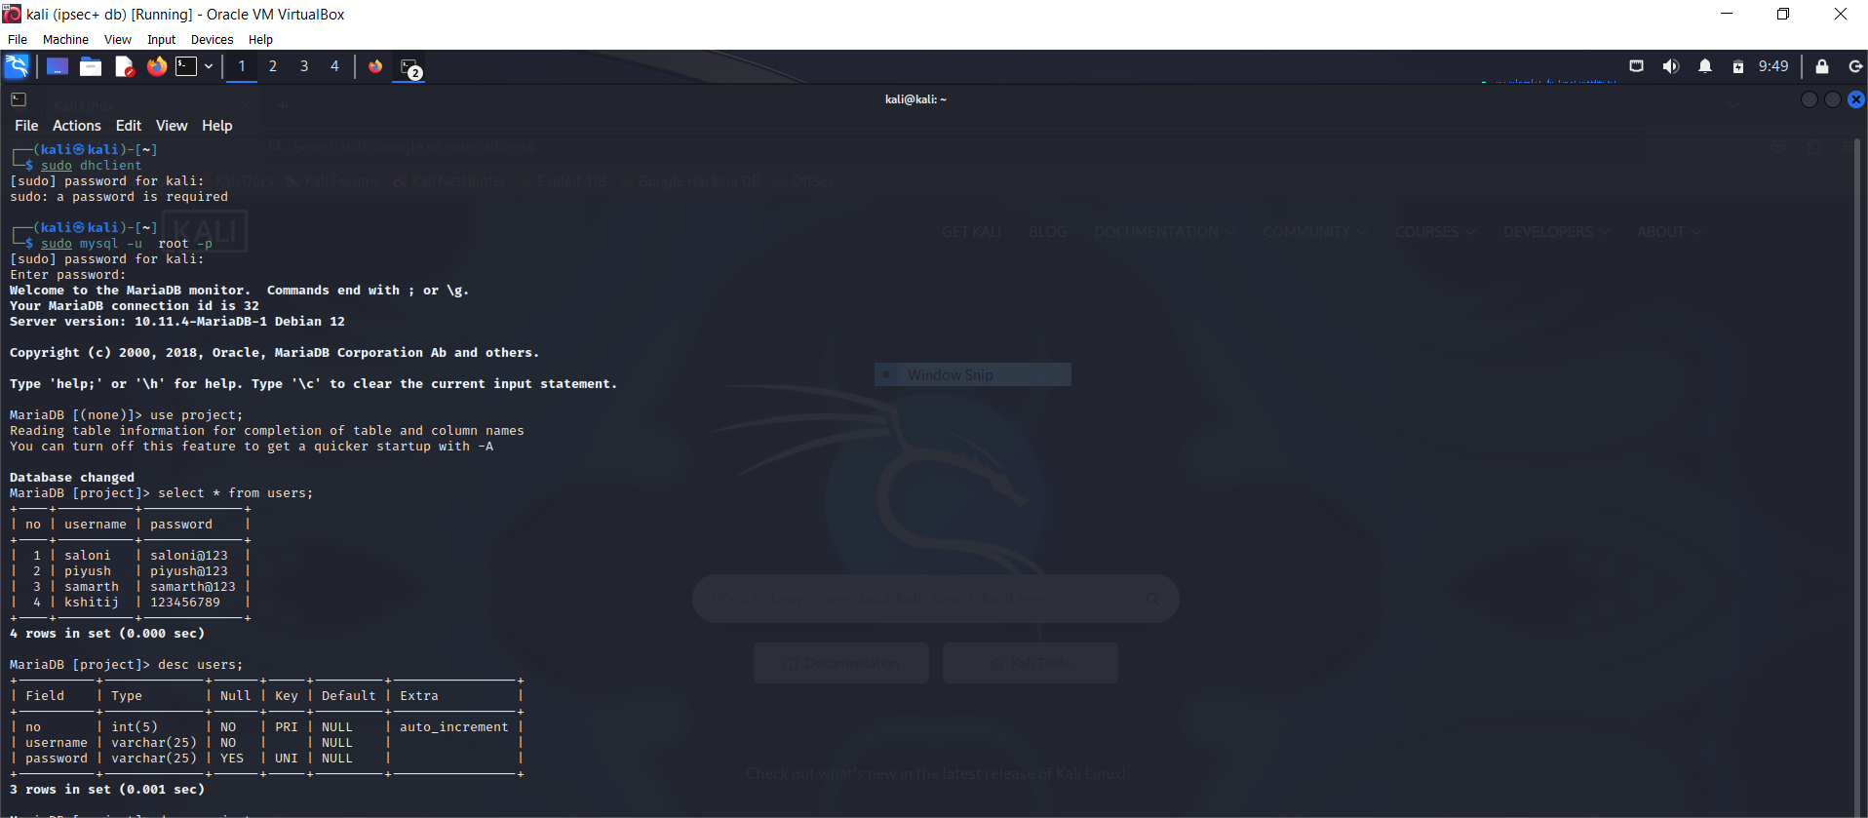
SQL -

Slide 14
IPsec -
Internet Protocol Security (IPsec) was implemented to establish a secure connection between the web server and the MySQL database. IPsec was chosen for its robust security features, including data encryption, integrity, and authentication, ensuring that sensitive data transmitted between the web server and the database remains protected from unauthorized access and tampering.
IPsec ensures that only authenticated and trusted devices can communicate, providing an additional layer of security through mutual authentication. This prevents unauthorized systems from accessing the database, thereby protecting the web application’s backend from potential breaches.
The implementation of IPsec in this project not only enhances the security of data transmission but also aligns with best practices for protecting sensitive information in a distributed architecture. By leveraging IPsec, I was able to create a secure, reliable, and efficient connection between the web server and the MySQL database, contributing to the overall resilience of the system.

Slide 15
IPsec -
To implement IPsec in our project, we utilized and configured strongSwan, an open-source IPsec-based VPN solution. strongSwan was chosen for its flexibility, robust security features, and ease of integration with various systems.
By leveraging strongSwan, we were able to establish a secure IPsec tunnel between the web server and the MySQL database, ensuring encrypted and authenticated communication.
This setup not only enhanced the security of our data transmission but also provided a reliable and scalable solution for our distributed architecture

Slide 16
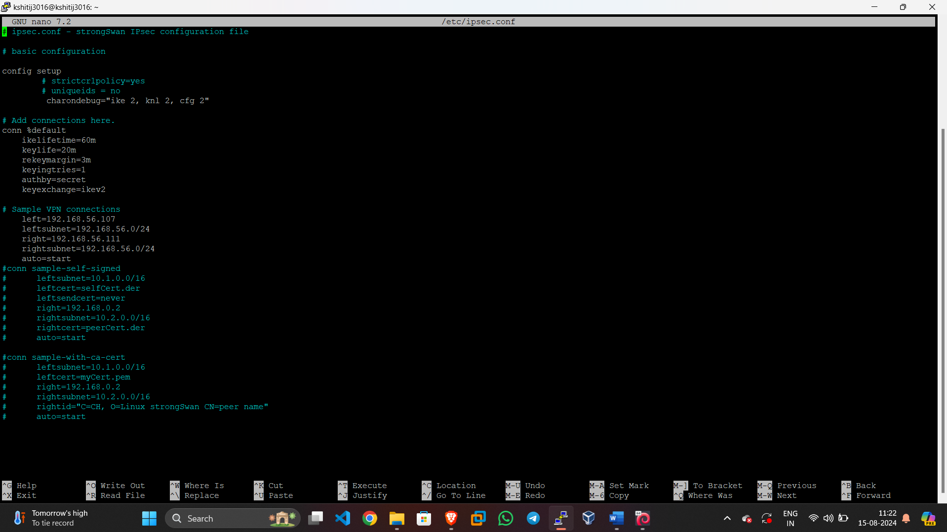
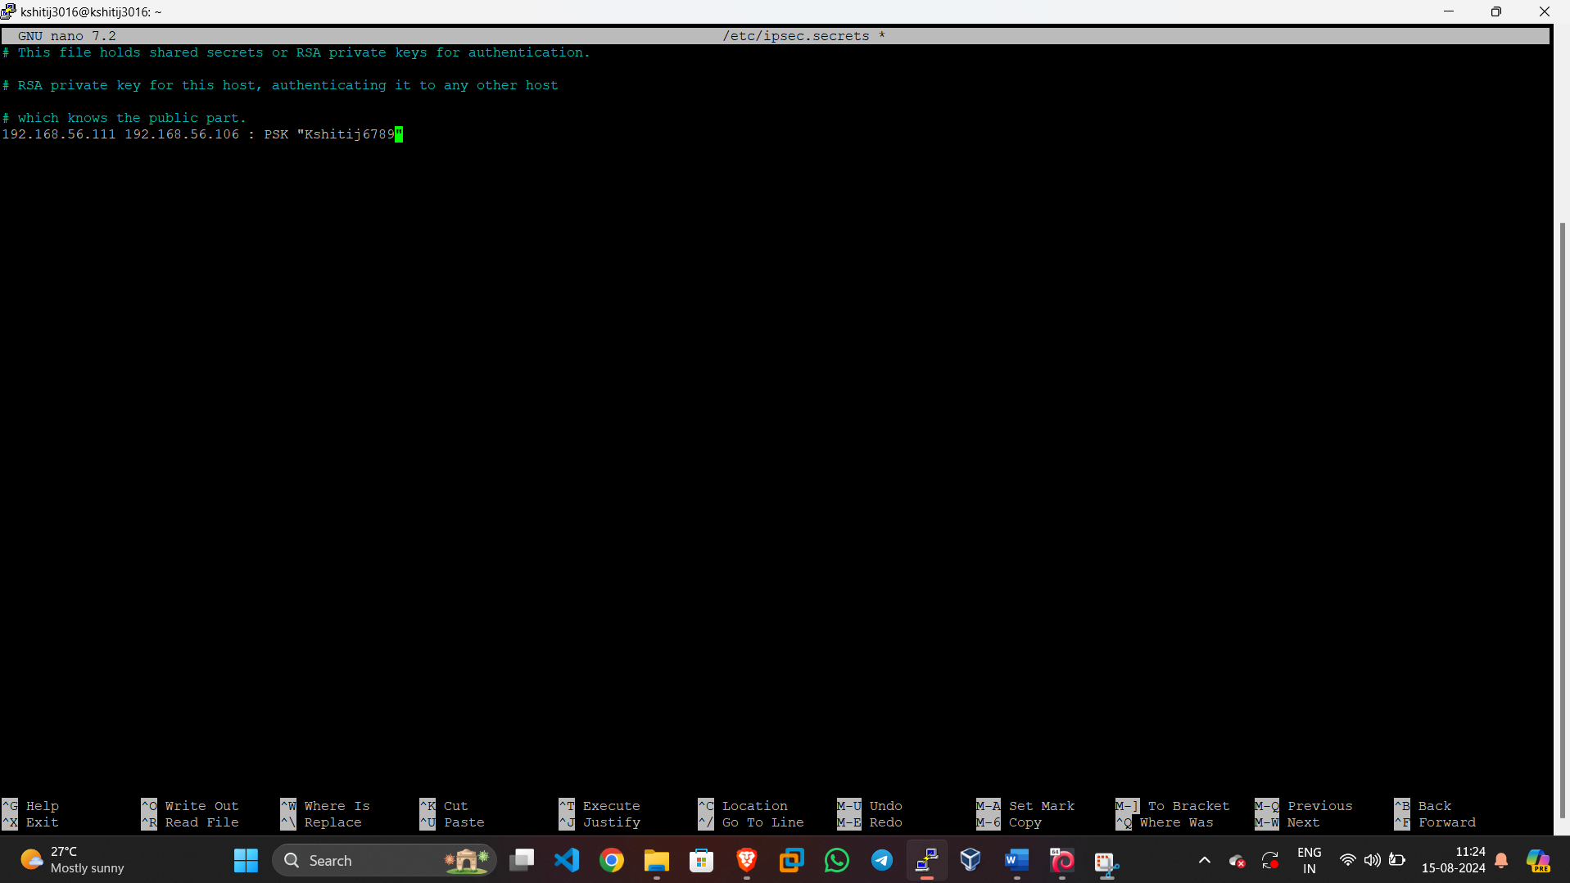
IPsec -

Slide 17
Apache2 -
Apache2, also known as the Apache HTTP Server, is a widely-used open-source web server software developed by the Apache Software Foundation. It is renowned for its reliability, flexibility, and extensive feature set, making it a popular choice for hosting websites and web applications. Apache2 operates on a modular architecture, allowing administrators to enable or disable features as needed through various modules.
In your project, Apache2 was utilized to host a simple website, demonstrating its capability to serve static and dynamic web content efficiently. The server listens for incoming requests from clients (e.g., web browsers) and responds by delivering the requested web pages.
Apache2’s compatibility with various operating systems, including Unix-like systems and Windows, further enhances its versatility and widespread adoption.

Slide 18
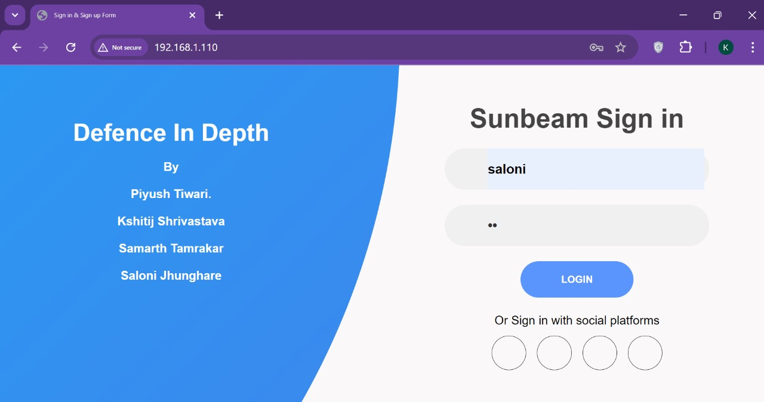
Apache2 -

Slide 19
Nginx -
NGINX is a high-performance web server and reverse proxy known for its speed, scalability, and reliability. It efficiently handles many concurrent connections, making it ideal for serving static and dynamic content and acting as a gateway to backend servers.
As a reverse proxy, NGINX forwards client requests to backend servers and returns their responses, distributing the load, enhancing security, and enabling SSL termination. In our project, NGINX routes traffic based on URL patterns, ensuring a seamless user experience.
For load balancing, NGINX distributes incoming traffic across multiple backend servers using algorithms like round-robin, least connections, and IP hash. This improves resource utilization, reduces latency, and enhances fault tolerance, leading to better performance and reliability for our web applications.

Slide 20
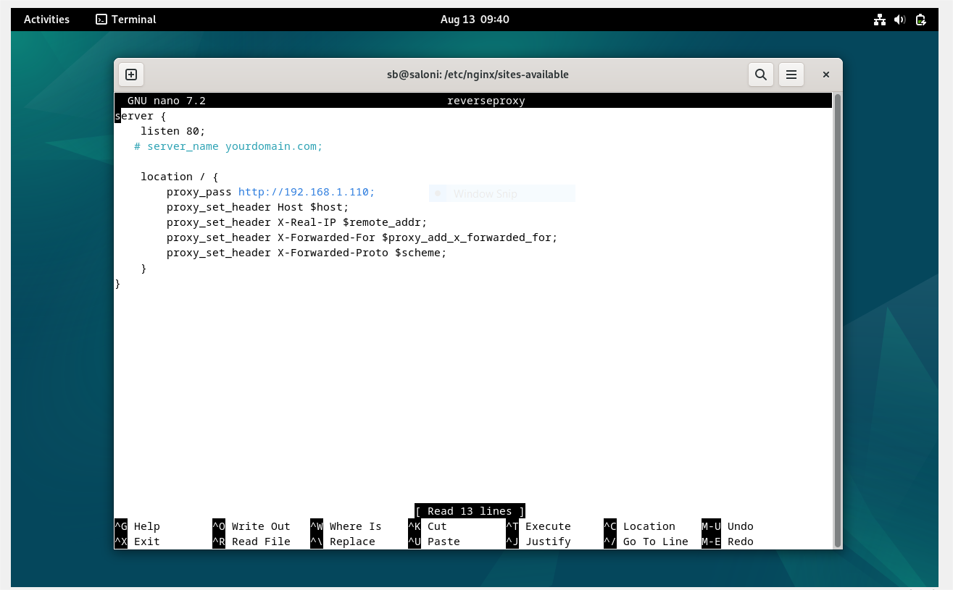
Nginx -

Slide 21
IPtables -
IPtables is a user-space utility program that allows system administrators to configure the IP packet filter rules of the Linux kernel firewall. It is used to manage and control the flow of network traffic to and from a Linux system. IPtables organizes its rules into tables, each containing chains of rules that specify how packets should be treated.
In your project, you used the filter table for packet filtering. This table includes three built-in chains: INPUT (for packets destined for the local system), OUTPUT (for packets generated locally and sent out), and FORWARD (for packets routed through the system). By defining rules in these chains, you can control which packets are allowed or denied, enhancing the security and management of network traffic.

Slide 22
DNS -
DNS (Domain Name System) translates human-friendly domain names (like www.example.com) into IP addresses (like 192.168.1.1) that computers use to identify each other on the network. It functions like an internet phonebook, allowing users to access websites using easy-to-remember names instead of complex numerical IP addresses. DNS operates through a hierarchical and distributed database system, ensuring efficient and reliable domain name resolution globally.
In your project, DNS resolved the domain name of your website hosted on an Apache2 server. When a user types your website’s domain name into their browser, DNS translates it into the corresponding IP address of your Apache2 server, enabling the browser to locate and load your website. This involves multiple DNS servers, including recursive resolvers, root name servers, TLD servers, and authoritative name servers, each playing a crucial role in the process.

Slide 23
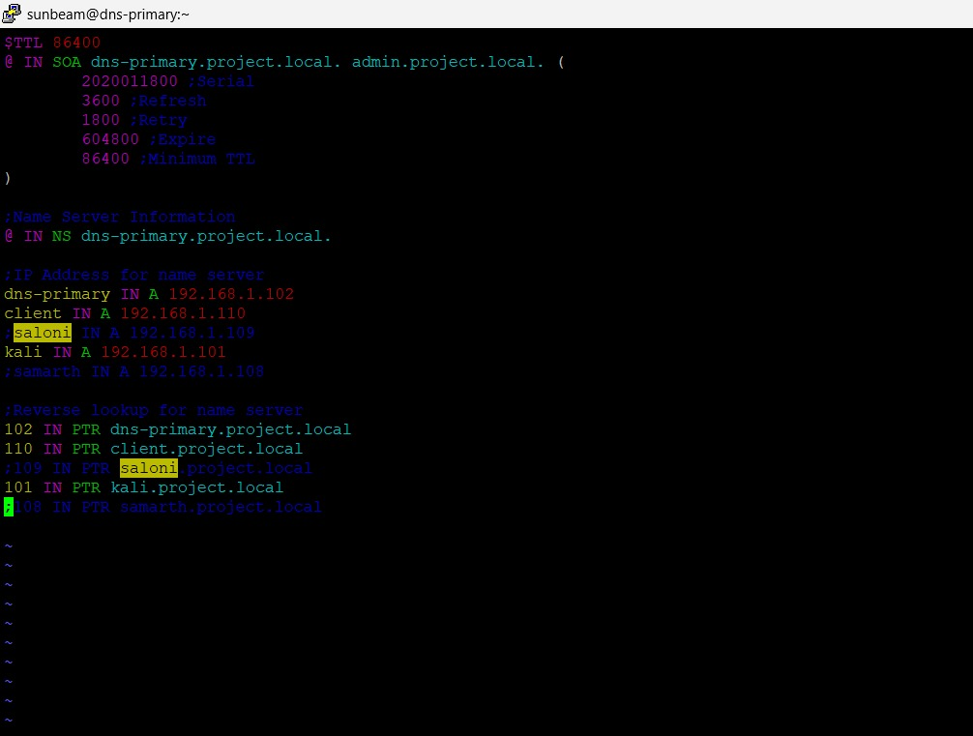
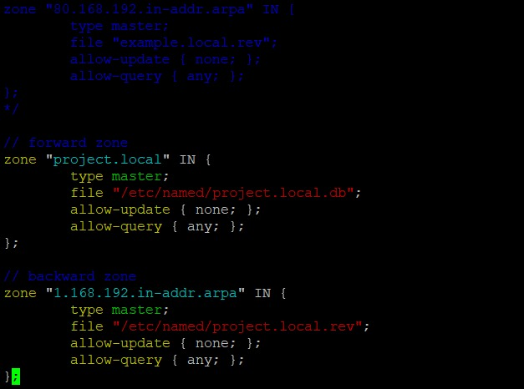
DNS -

Slide 24
Thank You

